Slide 1
Forests in Poland and Europe. Characteristics and management
Competition slideshow

Slide 2
We divide function of forest into productive and
non-productive.
We take care of forests’ non-production functions.

Slide 3
CO₂ absorption
The forests absorb CO₂ and produce oxygen necessary for people, animals and plants. In this way they protect us from the harmful effects of the industry.

Slide 4
The impact of forests on human
Forests have also recreation function. Their beauty attracts people who are looking for a break from everyday life.

Slide 5
People can do a lot of relaxing things in the forest:
Walking with friends,
Taking a dog for a walk,
Collecting mushrooms,
Playing sports (running etc.),
Putting a tent and rest in the forest.

Slide 6
Animals in a forest
Forest is the safe place for every kind of animals.

Slide 7
The impact of forests on the environment:
Forests produce more than half of oxygen in the world per year,
Forests absorb CO₂,
Forests defend us from flood,
Forests clean our air from dust,
Forest lower level of noise.

Slide 8
In metropolises and cities one of the biggest problem is air polution and noise.
Because of that people started building parks. They are really usefull in case of polution. Parks are also the places where citizens can rest from the noise.

Slide 9
And there are some photos took by us in nearby forest.

Slide 10
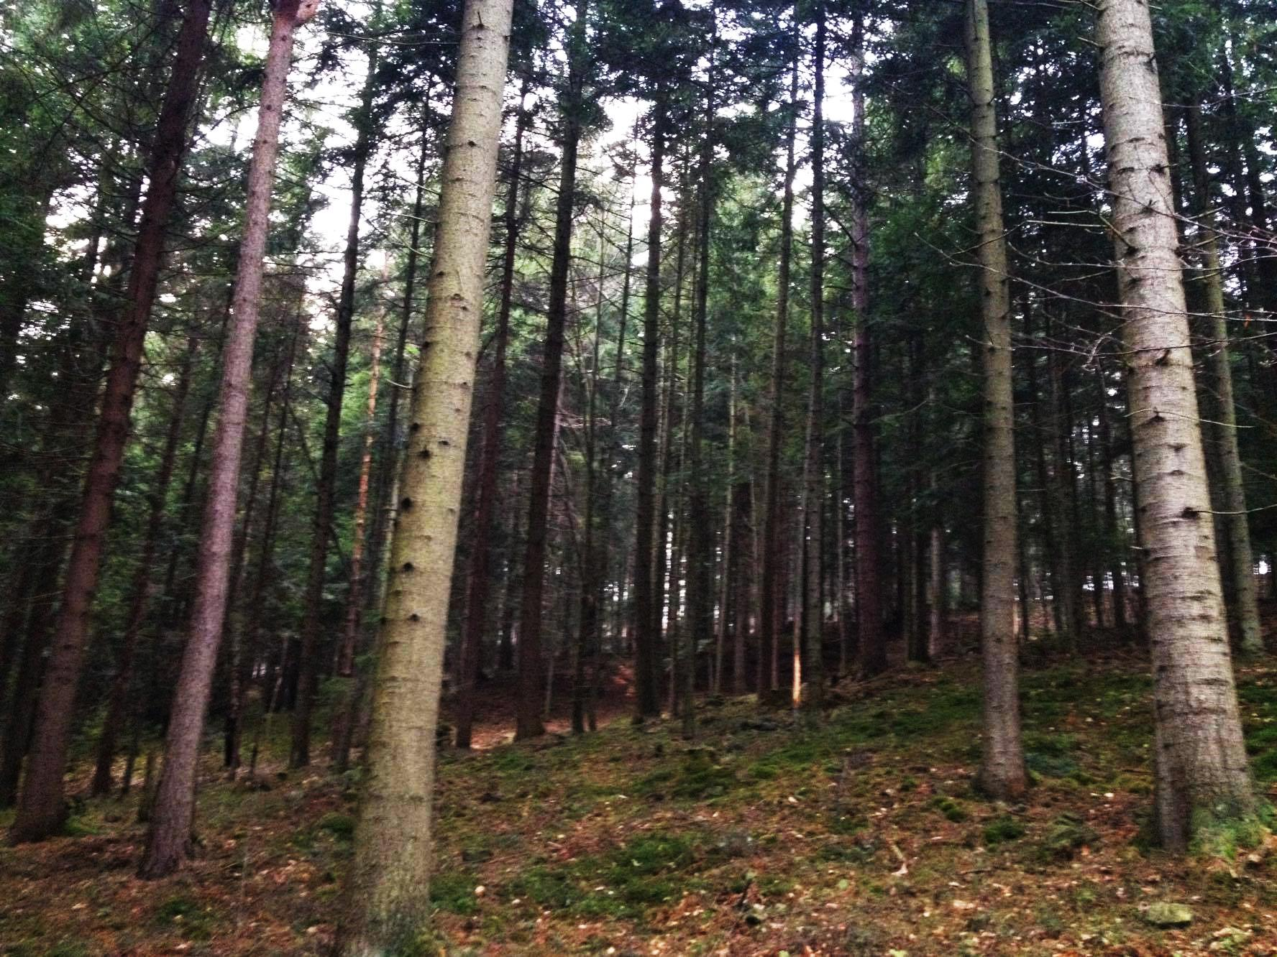

Slide 11
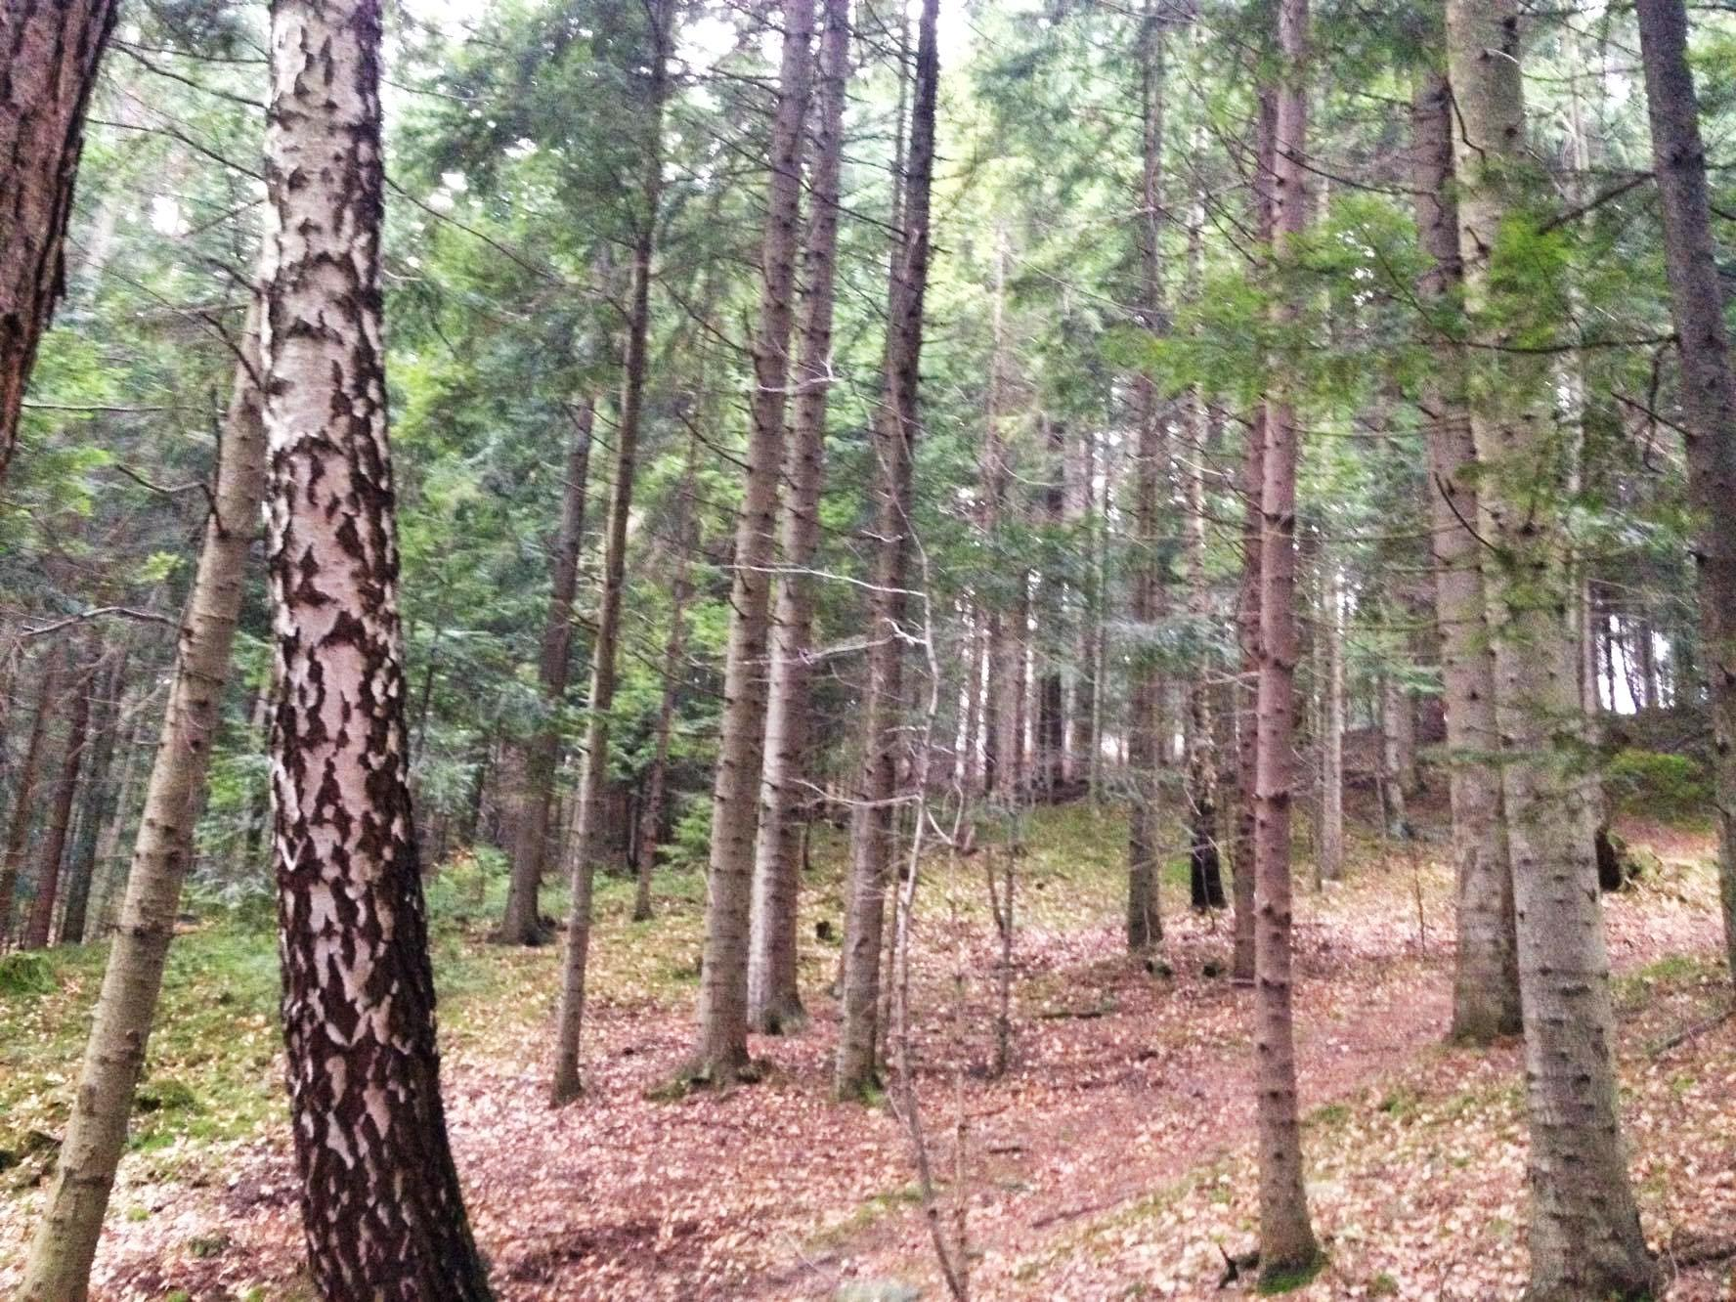

Slide 12
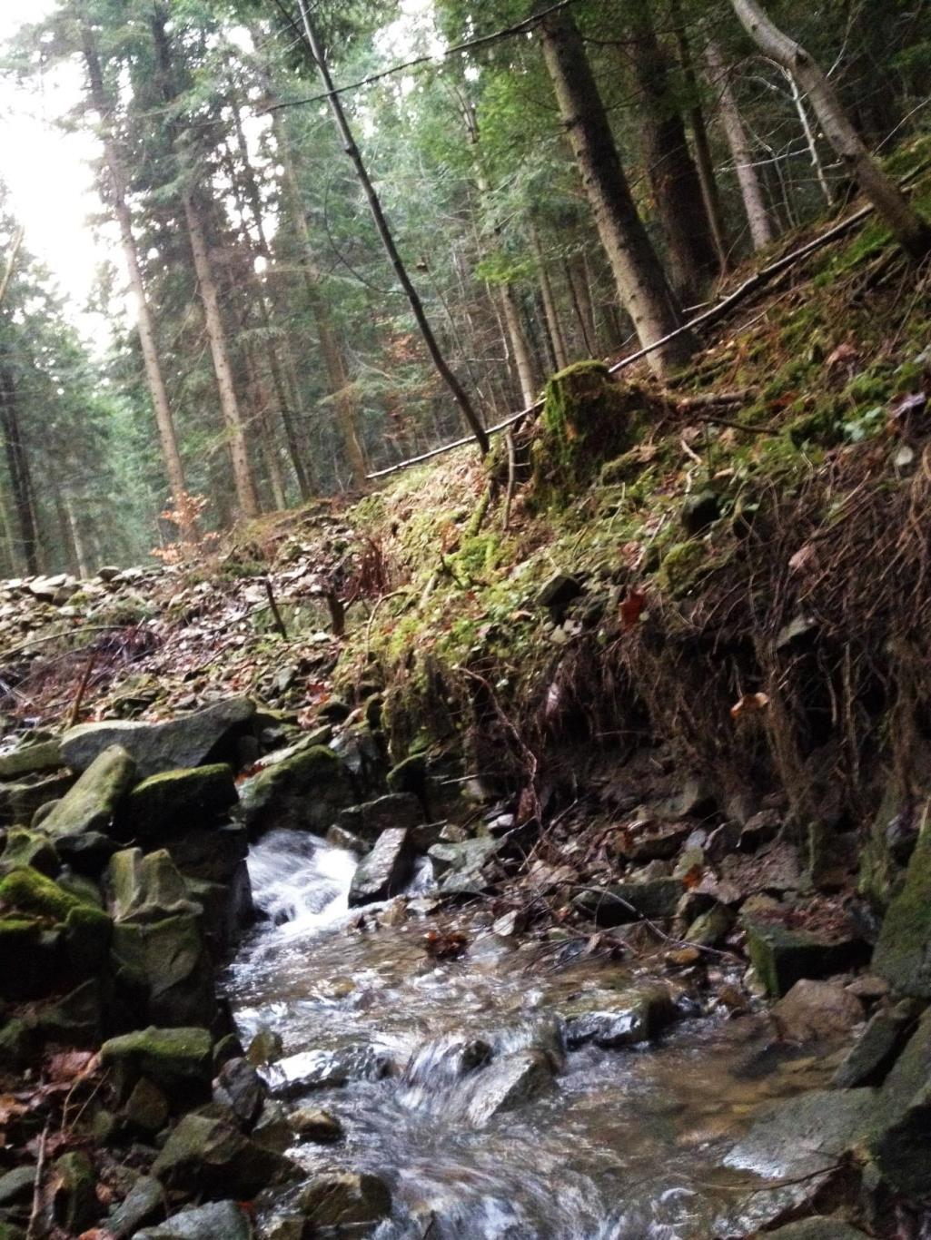
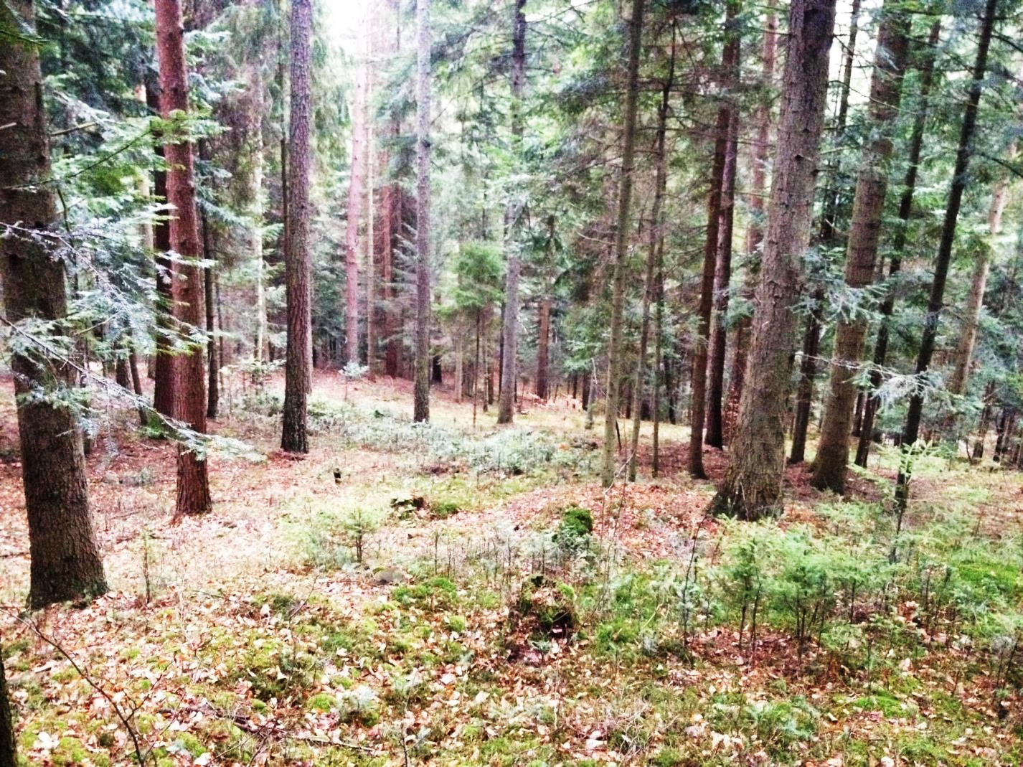

Slide 13
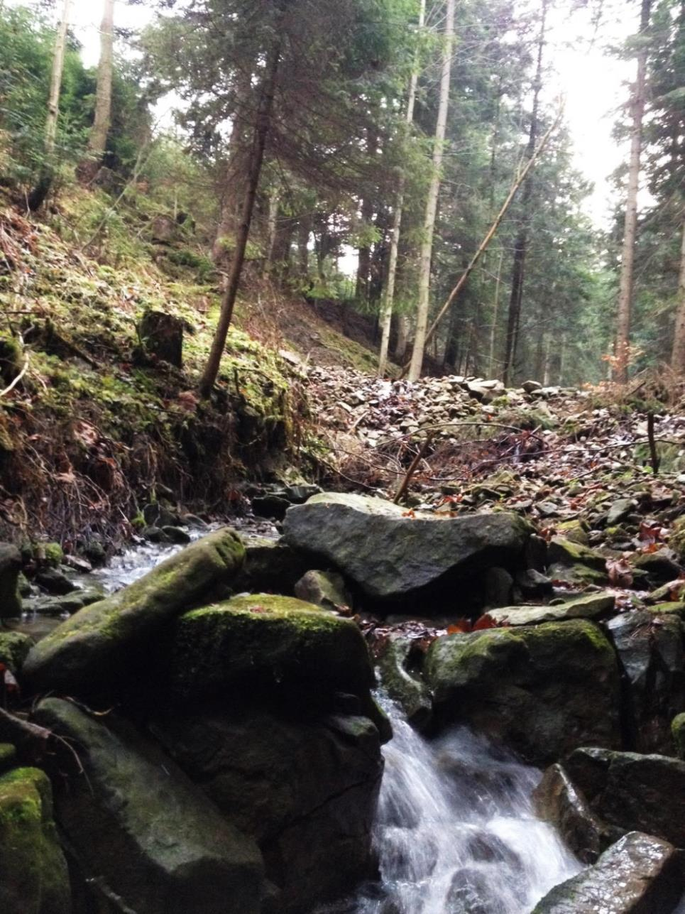
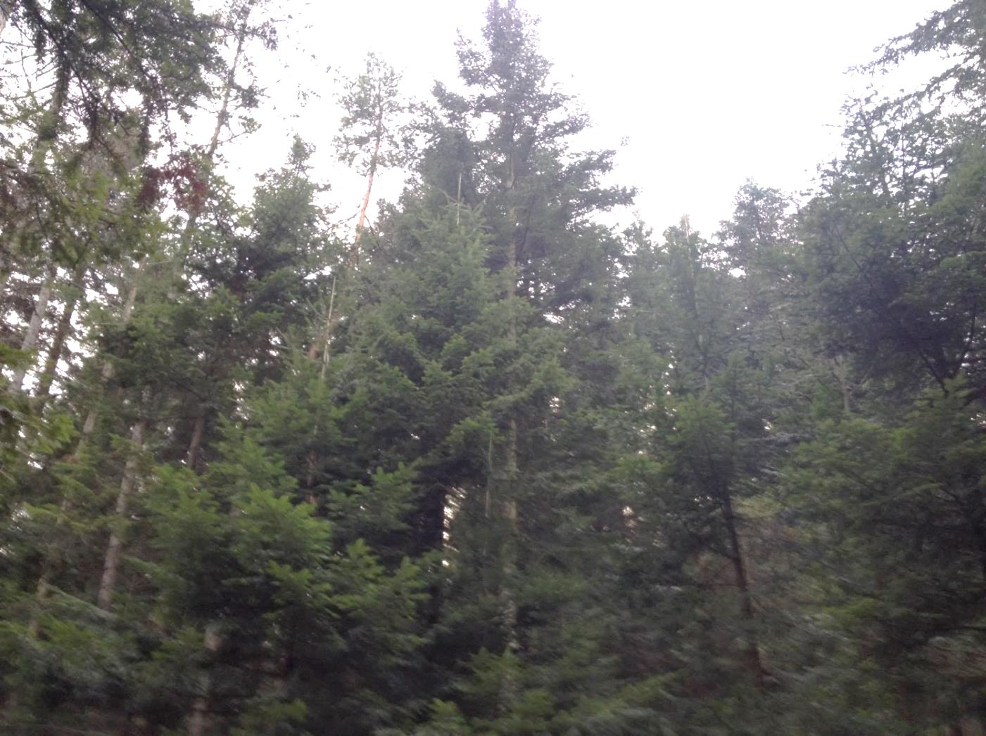

Slide 14
Despite of the benefits and the beauty of the forests, people don't care of them. The forests are full of rubbish left by people. We should take care of the forests, because we need them.

Slide 15
The End
Thanks for watching ☺
Karol Kanicki
Dawid Steczek
Artur Lenart

